Slide 1

Search Decomposition
By Jeffrey Van Etten, Sean Russell, and Wei Xi
Notes:
Shrink this video

Slide 2
Background
The World
3d grid world, 11x6x11
World populated with colored blocks and 1 drone
Blocks obey gravity and can be stacked
Blocks can’t occupy same space
Drone can pick up and move blocks
The Problem
Planning problem
Find sequence of actions that takes agent from start to goal
Examples: pathfinding, travelling salesman
In our case figure out how to move drone to assemble blocks into desired pattern

Slide 3
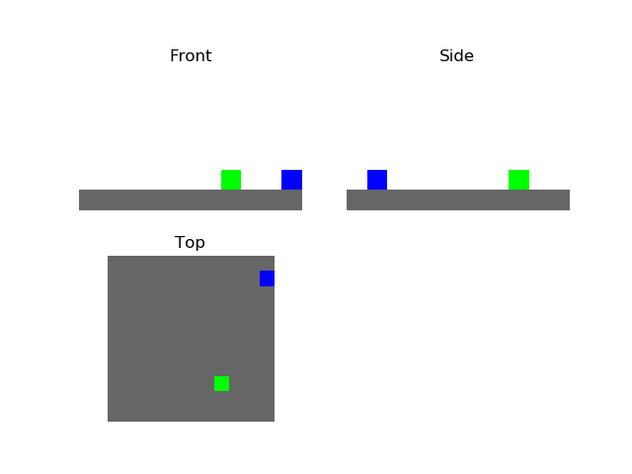
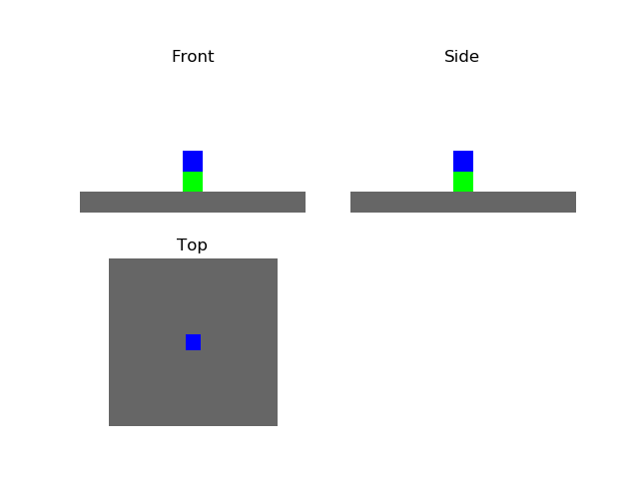
Example start and goal states to illustrate problem

Slide 4
First attempt: BFS
Breadth first search
Usually, only works on easy problems, like moving a cube 2-3 spaces but did well with stacking 3 cubes that were close together and parking the drone.
Branching factor up to 25, exponential complexity with length of path
Typically, cannot solve difficult problems, runs out of memory

Slide 5
Second attempt: Greedy Best First Search
Visits next state based on heuristic function values
A good heuristic is often very complicated, however, this one was fairly simple: get to the target using ranked moves - plus an optimal move added “just to see how it performed”
Did quite well for this project.
Still may suffer from memory issues

Slide 6
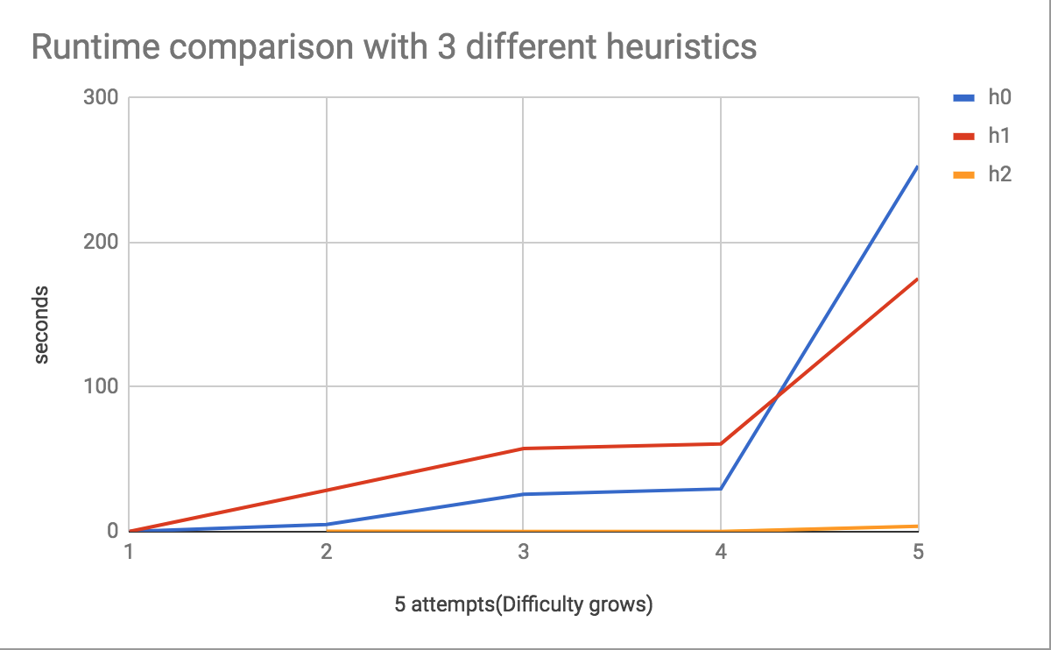
Third attempt: A*
Data from several different heuristics with A*
h0: Total cube offset distance
h1: Smallest distance between drone and a misplaced cube
h2:
If drone not attached: Smallest distance between drone and a misplaced cube.
If drone is attached: offset distance of attached cube

Slide 7
What we learned from A*
Solved more difficult problems than BFS, but still struggles with high branching factors
Heuristics need to get really complicated to solve difficult problems
Works very well for simple drone navigation

Slide 8
Finally, Decomposed Search
2 parts, planner and mover
Mover uses drone to move a single block with A* for navigation
Planner comes up with abstract plan for how blocks need to move using greedy hill climb algorithm, ignores drone and how blocks actually move

Slide 9
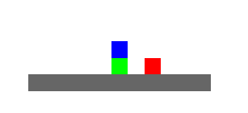
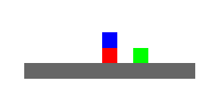
Planner and heuristic
Planner follows different rules from normal simulation, can move any block on top to any open position
Uses heuristic that heavily penalizes obstructions, like blocks on top of other blocks that need to be moved

Slide 10
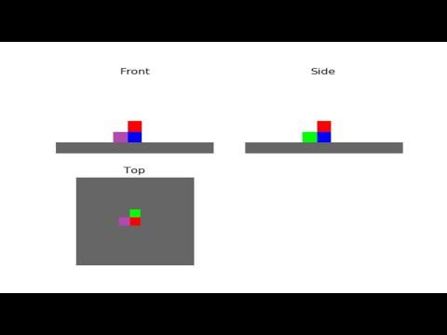
The Planning Phase

Slide 11
Move the blocks with the drone

Slide 12
In conclusion
Breaking problem into two pieces worked extremely well, solving problems that our other algorithms couldn’t.
Heuristic selection played a big part in getting computer to do good problem solving

Slide 13
Aliens built the pyramids

Slide 14
Thank you!

